Slide 1

CREDIT EDA STUDY
Gevi Ackshaya

Slide 2
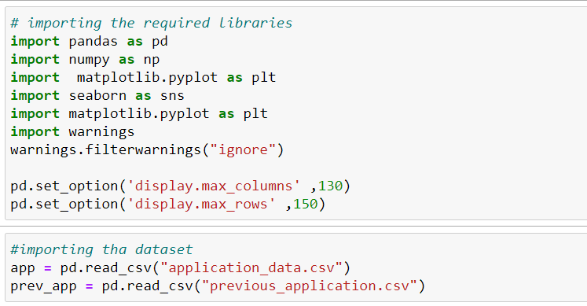
DATA UNDERSTANDING
We first import the libraries to work with as seen in the image
Using the pandas library we import the datasets using the pd.read_csv function

Slide 3
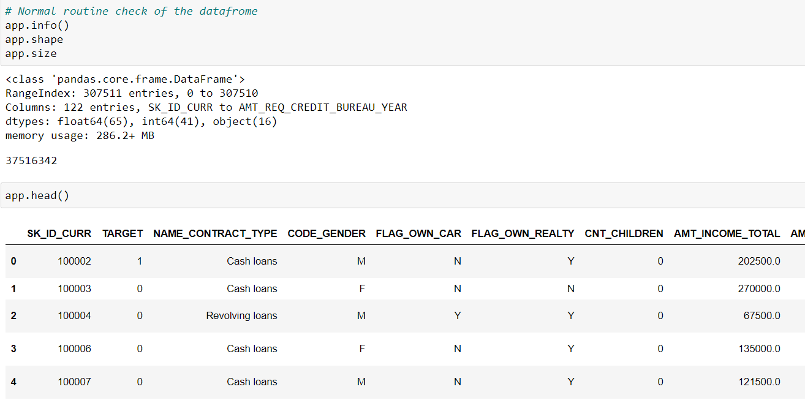
Data Understanding
We check the imported data set for info, shape and size of the data set.
We use the head function to see the rows and columns and get a general understanding of the dataset provided.
We see that the data has 307511 entries and has 122 columns from SK_ID_CURR TO AMT_REQ_CREDIT_BUREAU_YEAR

Slide 4
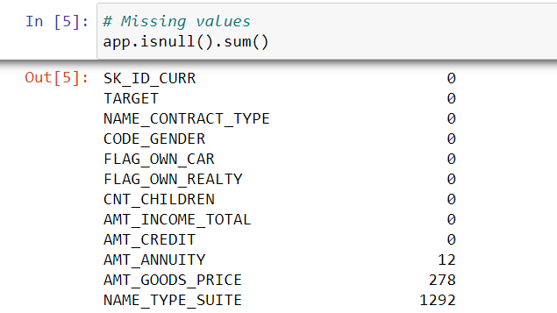
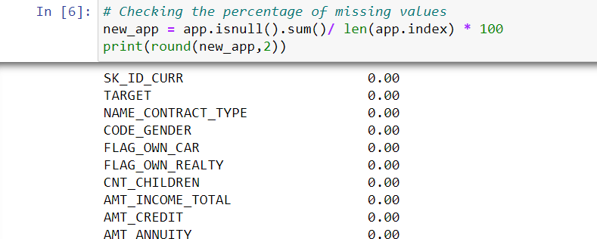
Data Cleaning
We need to check the missing values using the is null function and display the result
We check the percentage of missing values present in the data set
We find the columns containing missing values more than 50% and dropping them
We search for columns having missing values percentage less than 13% to get them filled.

Slide 5
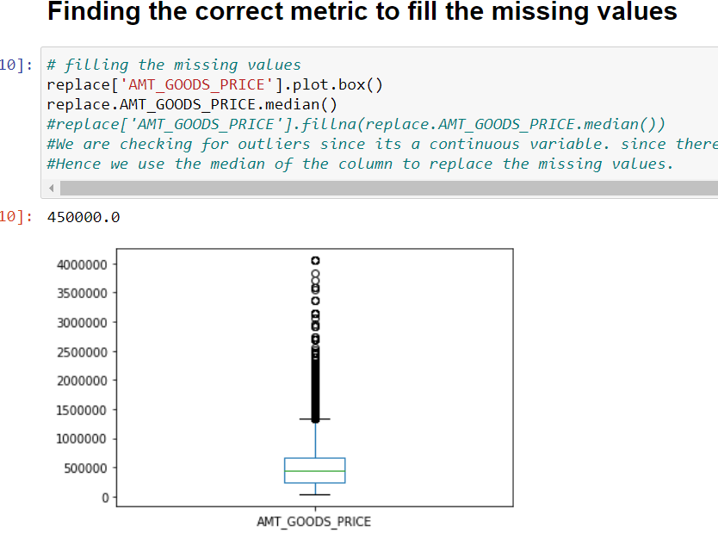
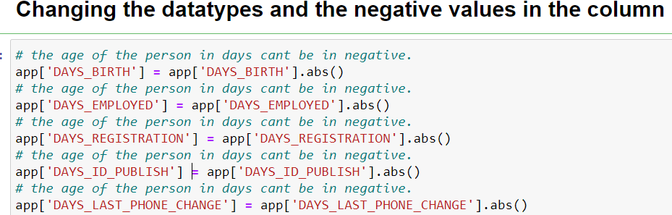
Data Cleaning
We fill the missing values using the appropriate metric.
Changed the data type to use the values more appropriately.
We change the columns using the abs function so that we are able to use the data for analysis

Slide 6
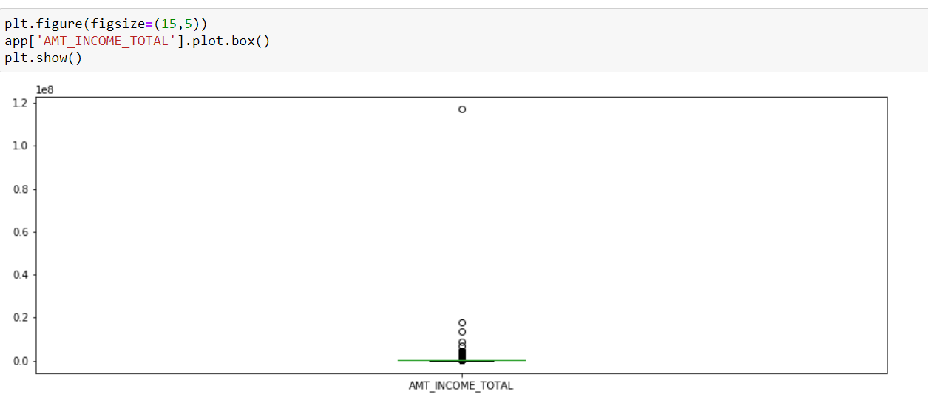
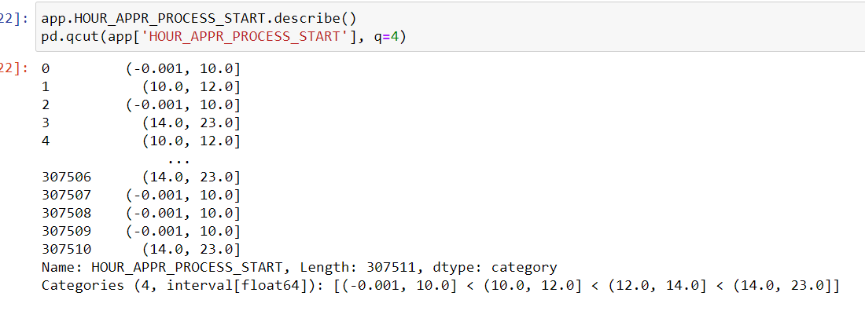
Data Cleaning
We plot the numerical variables to find out visually if there are outliers present in the data.
We do binning of continuous variable to sort the values into proper bins
We use the pd.qcut method to do binning of continuos variable.
The HOUR_APPR_PROCESS_START has been binned into 4 bins

Slide 7


Data Analysis
In analysis we do univariate and bivariate analysis on the data
We divide the data into Target=0 and Target = 1 using the Target column present in the dataset.

Slide 8
Univariate Analysis
Categorical Variables

Slide 9
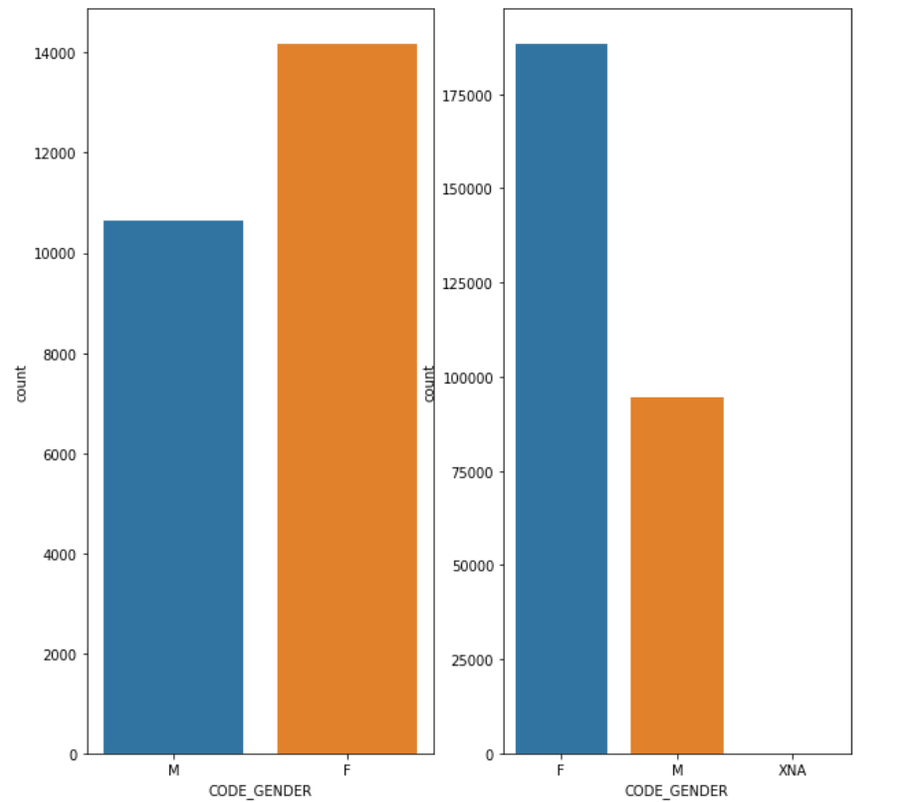
Distribution based on code Gender
The first graph represents the distribution of Target 1 and the second one represents the distribution of Target 0
It is proved from both the graphs that most no. of defaulters and credit payers both are of Females.
The ratio of Male defaulters are more than the ratio of Males who paid the loan on time when compared to Female of the same category.

Slide 10
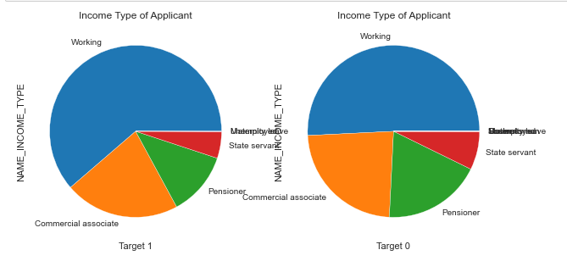
Distribution based on Income Type
Working Professionals are the major defaulters which sums up as more than 50% .
More Pensioner pay their loan on time.
There are a few State servants too who are defaulters.

Slide 11
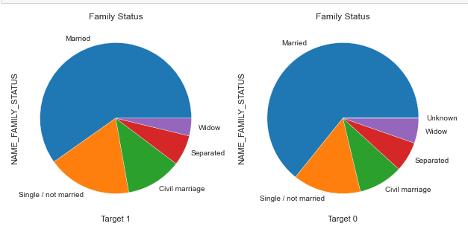
Distribution based on Family Status.
Married people hold the major ratio in both defaulters as on time payers.
The least number of defaulters are widows
Bank can concentrate on Separated and Widow for loan approvals.

Slide 12
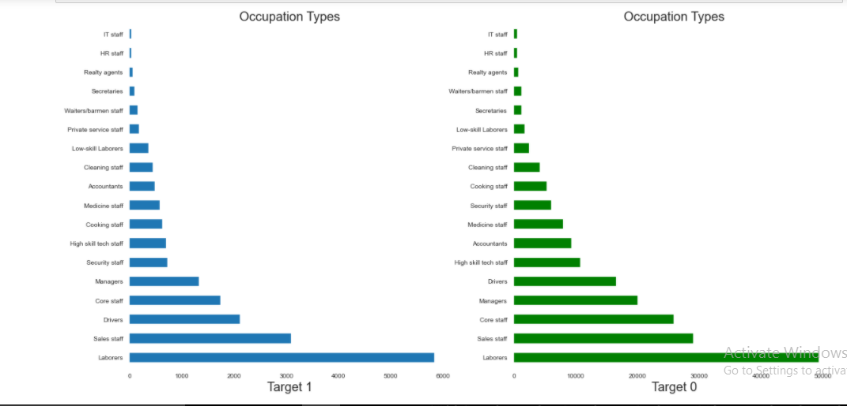
Distribution based on Occupation .
IT staffs hold the least ratio of defaulters followed by HR Staffs
Bank can concentrate on these people for loans because they hold the least ratio on active payers too….

Slide 13
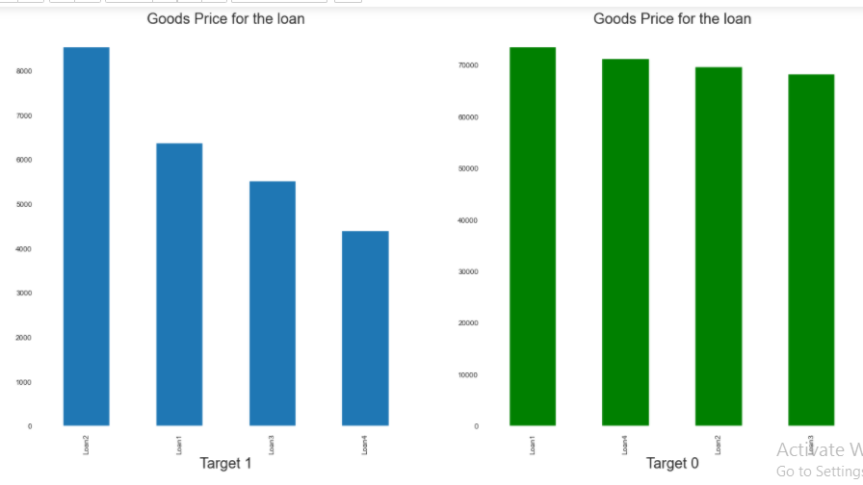
Distribution based on Goods Price for the Loan .
Most no. of defaulters are the people who got Loan of type LOAN 2.
The on-time payers don’t really show any amount of variance in the
The bin value of Loan 2 is 238500.0 - 450000.0

Slide 14
Univariate Analysis
Continuous Variables

Slide 15
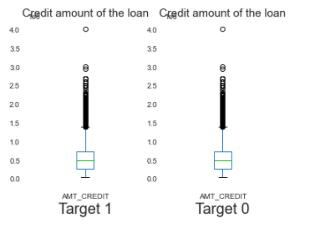
Box Plot of Credit Amount
We are able to find many outliers in credit amount
The third quantile is bigger than first …which means most of the credit amount lies in the third quantile.

Slide 16
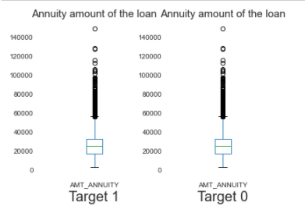
Box Plot of Annuity Amount
We are able to find some outliers in annuity amount
The third quantile is bigger than first …which means most of the credit amount lies in the third quantile.

Slide 17
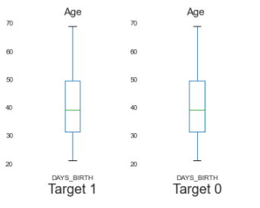
Box Plot of Age
There are no outliers found in the age of the people.
The third quantile is bigger than first …which means most of the loan payers are above the age of 50 .

Slide 18
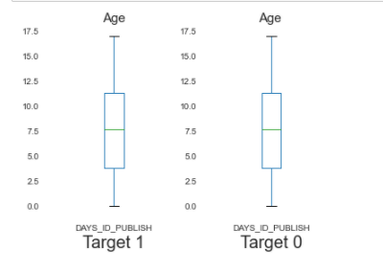
Box Plot of ID_PUBLISH
There are no outliers found in the DAYS_ID_PUBLISH.
This depicts that the average years of loan payers are the same and the third quantile is higher than the first.

Slide 19
Bivariate Analysis
Numerical Vs Numerical
Categorical Vs Numerical
Categorical Vs Categorical

Slide 20
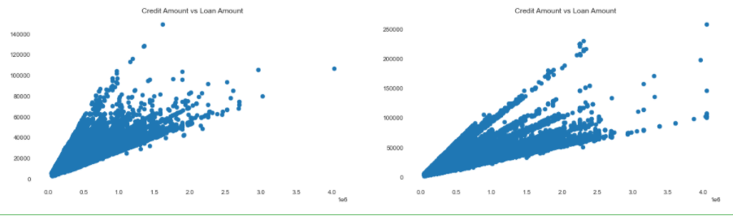
Credit Amount VS Annuity Amount
This is the analysis of a numerical and numerical variable
ScatterPlot is used for this analysis.
There are few outliers in the scatter plot of the Target 0 between credit amount and annuity amount.

Slide 21
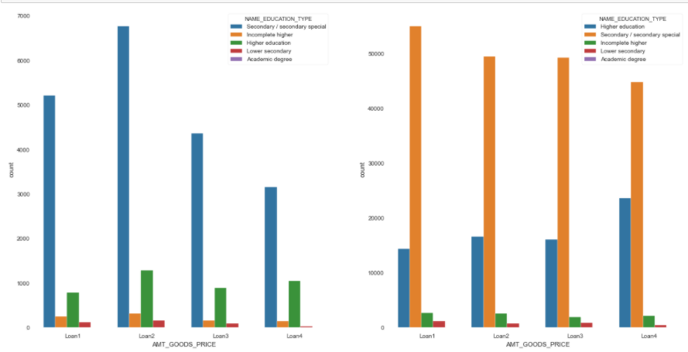
Education Status VS Amount Goods Loan
Performing categorical vs categorical variable
Target_1 – Graph1
Target_0 – Graph 2
Secondary education holders are the maximum loan seekers.
It is evident from the graph that only a least amount of Academic holders are defaulters.

Slide 22
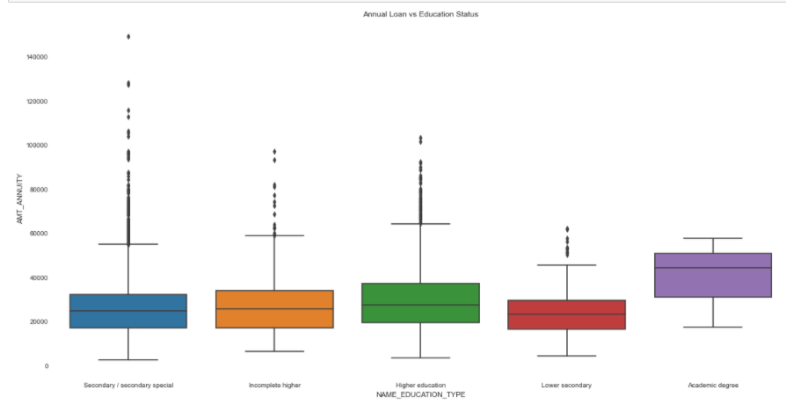
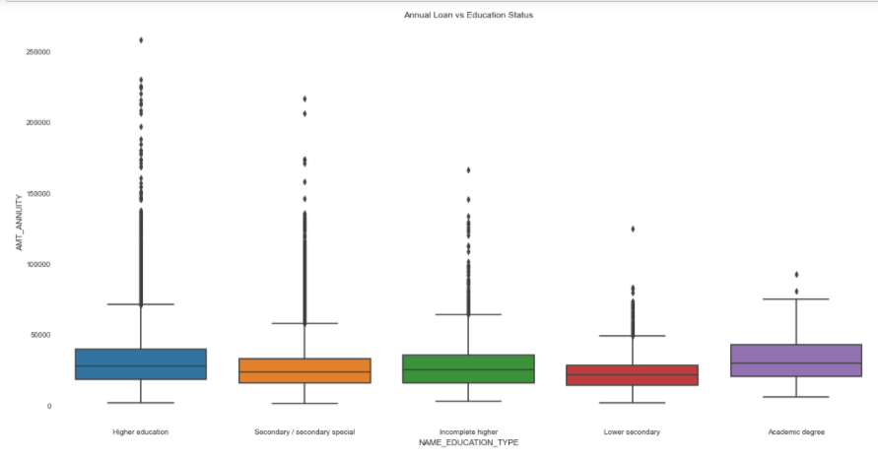
Bivariate analysis for Region Population vs Education Status
Performing analysis of categorical and numerical variables.
Target 1 – Graph 1
Target 0 – Graph 2
The following boxplot says that academic degree holders more ratio of defaulters than any other category.

Slide 23
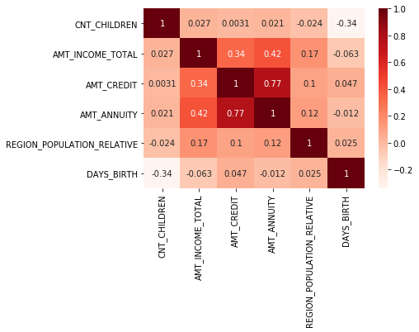
Correlation Matrix of Target 0
Observations from the matrix
Less children having clients live in densely populated areas.
Credit amount is inversely proportional to the number of children client have, means Credit amount is higher for less children count client have and vice-versa
Income amount is inversely proportional to the age of the person (i.e. DAYS_BIRTH)

Slide 24
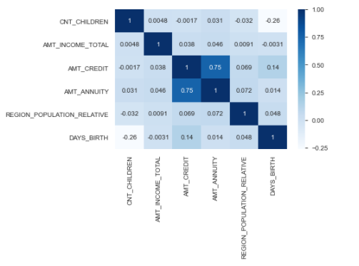
Correlation Matrix of Target 1
Observations from the matrix
Income amount is inversely proportional to the age of the loan holder.
Credit amount and Annuity Amount is almost related to each other.
Children Count and age is inversely propotional.

Slide 25
Merged Data Set
Univariate Analysis of the merged data sets

Slide 26
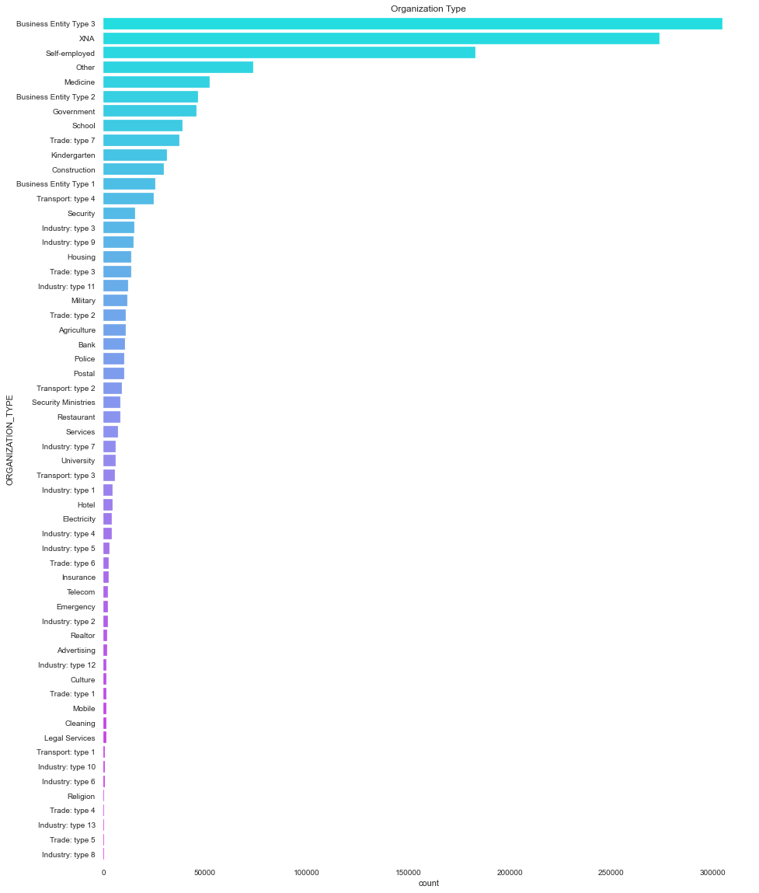
Organization Type
The graph depicts that the major no. of people work in the organization type “Business Entity Type 3”
Least no. of loan holders work in the organization type of Industry type - 13 ,5 and Trade type – 4,5

Slide 27
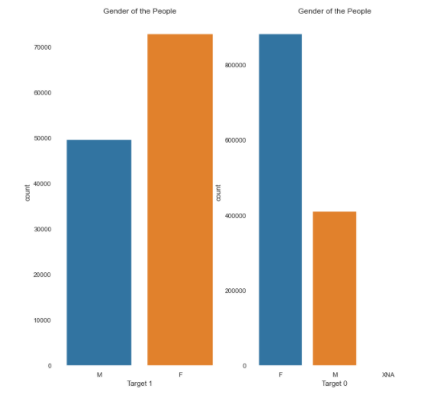
Distribution based on code Gender
The first graph represents the distribution of Target 1 and the second one represents the distribution of Target 0
It is proved from both the graphs that most no. of defaulters and credit payers both are of Females.
The ratio of Male defaulters are more than the ratio of Males who paid the loan on time when compared to Female of the same category.

Slide 28
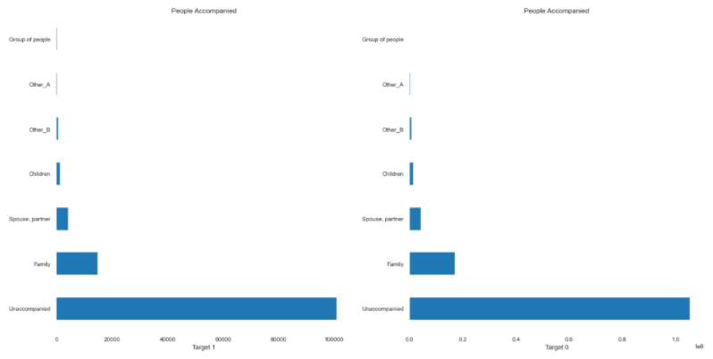
Analysis of NAME_TYPE_SUITE_x
Most of the people are seeking loan unaccompanied.
Only a few people seek loan through friends or other family members.

Slide 29
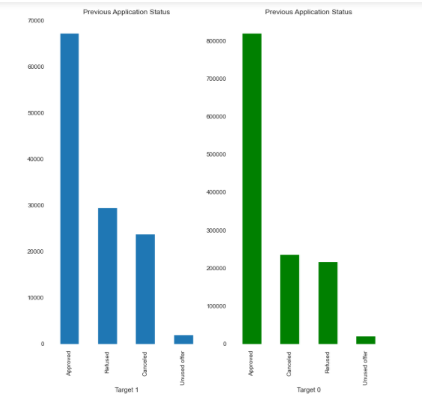
Analysis of NAME_CONTRACT_STATUS
Second most defaulters are people whose previous application for the loan was refused.
The visualization technique used for this is bar graph.

Slide 30
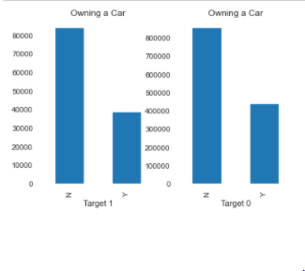
Analysis of FLAG_OWN_CAR
Most of the loan holders don’t own a car.
The ration of the defaulters who hold the car is half of the people who doesn’t own the car.

Slide 31
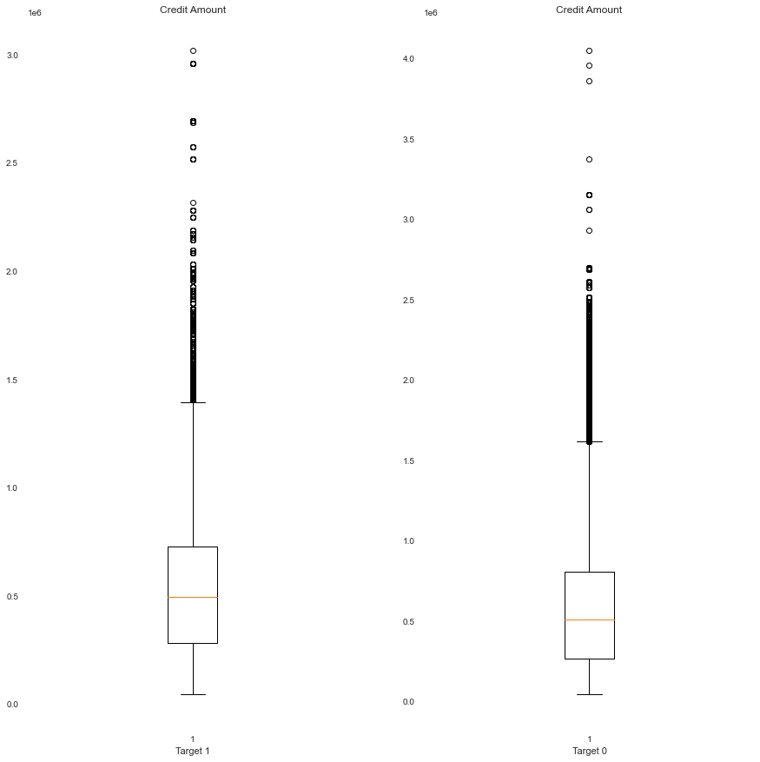
Analysis of Credit amount
The third quantile of the credit amount is larger than the first quantile.
There are few outliers in the credit amount.

Slide 32
Merged Data Set
Bivariate Analysis of the merged data sets

Slide 33
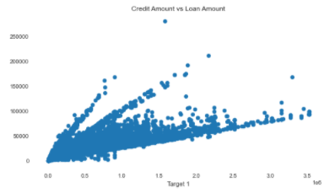
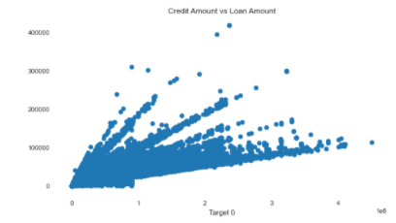
Credit Amount Vs Annuity Amount
This is the analysis of numerical and numerical variable.
Scatter plot is used for the analysis.
There are few outliers found in relation between the credit and annuity amount.

Slide 34
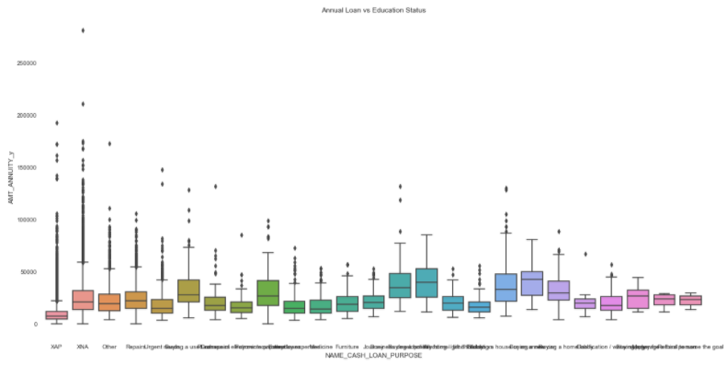
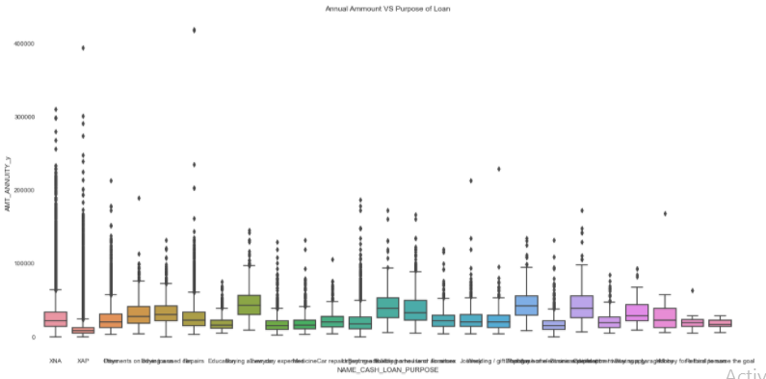
Purpose of the Loan VS Annuity Amount
Numerical VS Categorical Variable
Target 1 – Graph 1
Target 0 – Graph 2
Boxplot is used for the analysis
Housing Loan is the highest percent of the loan applied by the defaulters.

Slide 35
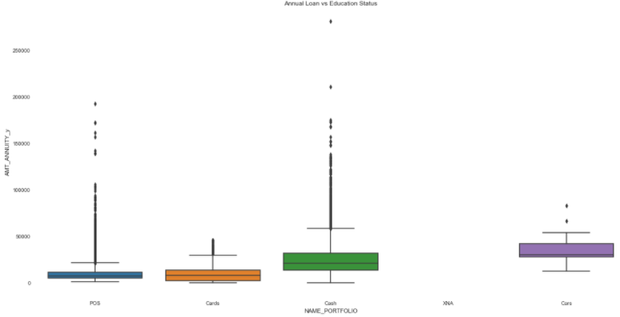
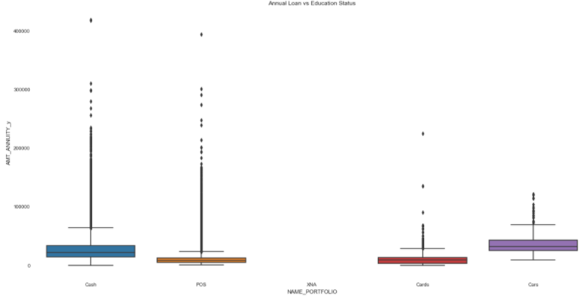
Portfolio of the Loan VS Annuity Amount
Numerical VS Categorical Variable
Target 1 – Graph 1
Target 0 – Graph 2
Boxplot is used for the analysis
The graph depicts that more defaulters are people whose previous application was for car loans.

Slide 36
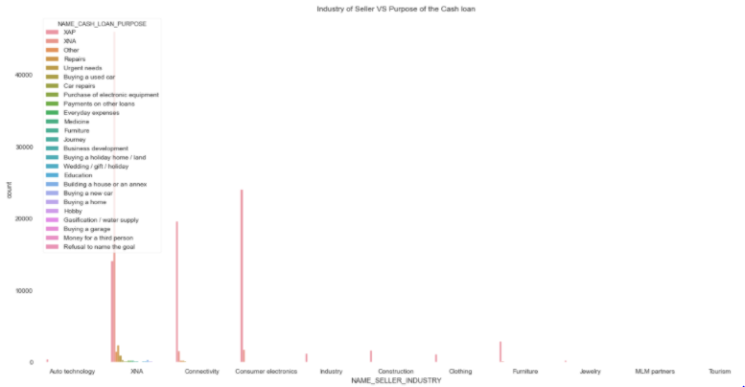
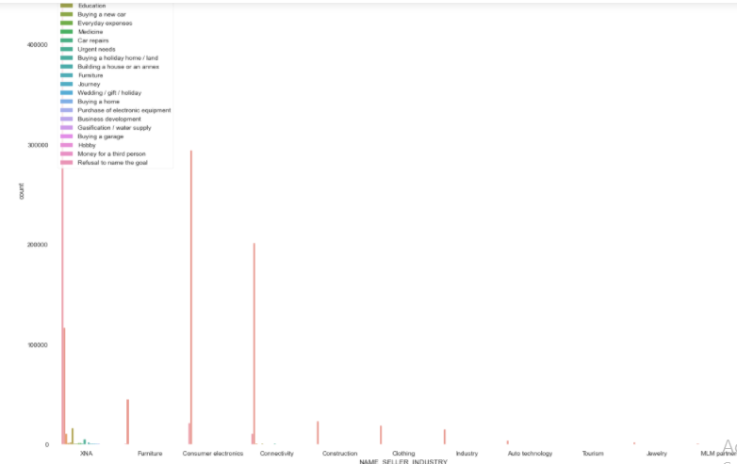
Industry of Seller VS Purpose of Cash Loan
Categorical VS Categorical Variable
Target 1 – Graph 1
Target 0 – Graph 2
Bargraph is used for the analysis
The graph depicts that more defaulters are people who belong to the industry of XNA.

Slide 37
Conclusion of the Analysis
Banks should focus less on income type ‘Working’ as they are having most number of unsuccessful payments.
Most of the unsuccessful payments were the loans taken for car and people who were unaccompanied.
Banks should focus on people with educational qualification as Academic Degree as they were having least number of unsuccessful payments.
Banks should focus on people with occupation type as IT Staff, HR Staff as they were having the least number of unsuccessful payments.

